Slide 1
Sprocket Central Pty Ltd
JYOTI MANOJ MANDAL

Slide 2
Agenda
Introduction
Data Exploration
Model Development
Interpretation

Slide 3

Introduction
Title: Customer Trends and Behavior Analysis for Sprocket Central Pty Ltd.
Welcome to the presentation on Customer Trends and Behavior Analysis for Sprocket Central Pty Ltd.
Sprocket Central is a long-standing client of KPMG, specializing in high-quality bikes and accessible cycling accessories.
The goal of this analysis is to gain valuable insights from Sprocket Central's existing customer dataset in order to understand customer trends and behavior.
By leveraging data-driven insights, we aim to help Sprocket Central boost their business and drive value through targeted marketing strategies.

Slide 4
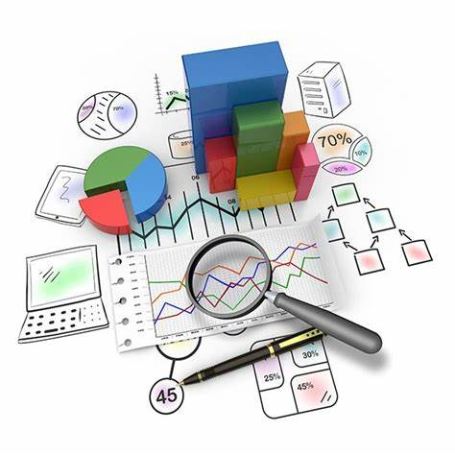
Data Exploration
This phase involves a comprehensive exploration of the customer dataset.
Perform statistical analysis and visualizations to gain insights into the data.
Understand the distributions, correlations, and patterns within each dataset.
Analyze customer demographics, behavior, and transactional data.
Identify any missing values or data inconsistencies that need to be addressed.
Conduct exploratory data analysis to uncover initial findings and trends.

Slide 5

Model Development
In this phase, we develop models to analyze customer trends and behavior further.
Utilize machine learning and data mining techniques to build predictive models.
Implement customer segmentation approaches to identify distinct customer groups.
Apply statistical modeling to understand the factors influencing customer behavior.
Use appropriate algorithms to forecast customer preferences and purchase patterns.
Fine-tune the models based on performance evaluation and validation.

Slide 6
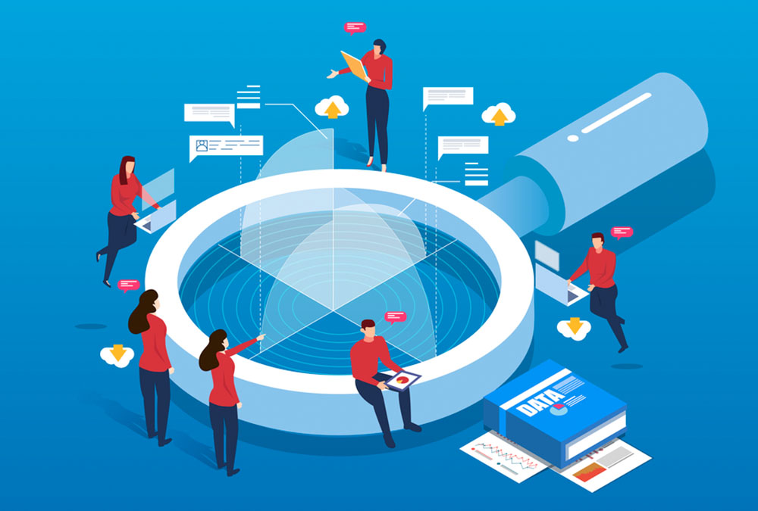
Interpretation
This phase focuses on interpreting the results and deriving actionable insights.
Analyze the output of the developed models and extract meaningful conclusions.
Identify key trends, patterns, and factors influencing customer behavior.
Generate insights related to customer preferences, purchasing habits, and demographics.
Provide recommendations for targeted marketing strategies and customer engagement.
Highlight the potential value and impact of leveraging the analysis for business growth.

Slide 7

Conclusion:
Summarize the key findings and insights derived from the analysis.
Emphasize the importance of leveraging data-driven insights for targeted marketing.
Present recommendations based on the identified customer trends and behavior patterns.
Highlight the potential business value and competitive advantage that can be achieved.
Conclude by expressing readiness to support Sprocket Central in implementing the recommendations and driving business growth.

Slide 8

Recommendations:
Targeted Marketing Campaigns:
Design personalized marketing campaigns based on customer segments.
Tailor marketing messages and promotions to customer preferences and demographics.
Product Assortment Optimization:
Analyze transaction data to identify popular products and customer preferences.
Optimize product assortment and introduce new items based on emerging trends.
Customer Retention Strategies:
Implement loyalty programs, special offers, and personalized recommendations.
Enhance the customer experience to encourage repeat purchases and loyalty.
Geographic Targeting:
Identify regions with high customer concentration from address data.
Develop targeted marketing campaigns specific to these areas.
Customer Segmentation Refinement:
Continuously update customer segments based on evolving trends.
Improve segmentation accuracy using customer feedback and engagement metrics.
Social Media and Influencer Marketing:
Leverage social media platforms and collaborate with influencers.
Reach a wider audience and increase brand visibility.
Customer Feedback and Reviews:
Encourage customers to provide feedback and reviews.
Use feedback to improve products and customer experience.

